Slide 1
5 Swipe Bob
Our Bob discovering Albert on its NYU Global Network
Understanding & Data Visualizing the Diversity of Choices on Albert available in the Global NYU community.
Utilizing: Academic data set.
Notes:
Our Bob discovering Albert on its NYU Global Network
Understanding & Data Visualizing the Diversity of Choices on Albert available in the Global NYU community by utilizing the Academic data set.

Slide 2

Notes:
Our Bob discovering Albert on its NYU Global Network
Understanding & Data Visualizing the Diversity of Choices on Albert available in the Global NYU community by utilizing the Academic data set.

Slide 3

Notes:
Our Bob discovering Albert on its NYU Global Network
Understanding & Data Visualizing the Diversity of Choices on Albert available in the Global NYU community by utilizing the Academic data set.

Slide 4

Notes:
Our Bob discovering Albert on its NYU Global Network
Understanding & Data Visualizing the Diversity of Choices on Albert available in the Global NYU community by utilizing the Academic data set.

Slide 5

Notes:
Our Bob discovering Albert on its NYU Global Network
Understanding & Data Visualizing the Diversity of Choices on Albert available in the Global NYU community by utilizing the Academic data set.

Slide 6

Notes:
Our Bob discovering Albert on its NYU Global Network
Understanding & Data Visualizing the Diversity of Choices on Albert available in the Global NYU community by utilizing the Academic data set.

Slide 7

Notes:
Our Bob discovering Albert on its NYU Global Network
Understanding & Data Visualizing the Diversity of Choices on Albert available in the Global NYU community by utilizing the Academic data set.

Slide 8
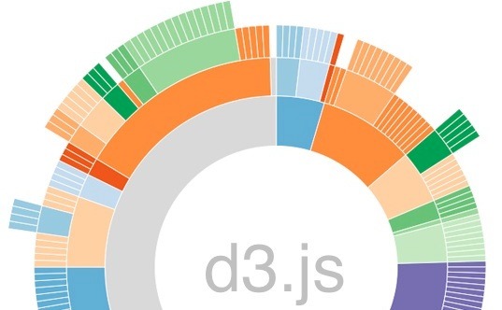
Notes:
Our Bob discovering Albert on its NYU Global Network
Understanding & Data Visualizing the Diversity of Choices on Albert available in the Global NYU community by utilizing the Academic data set.

Slide 9

Notes:
Our Bob discovering Albert on its NYU Global Network
Understanding & Data Visualizing the Diversity of Choices on Albert available in the Global NYU community by utilizing the Academic data set.

Slide 10

Notes:
Our Bob discovering Albert on its NYU Global Network
Understanding & Data Visualizing the Diversity of Choices on Albert available in the Global NYU community by utilizing the Academic data set.

Slide 11

Notes:
Our Bob discovering Albert on its NYU Global Network
Understanding & Data Visualizing the Diversity of Choices on Albert available in the Global NYU community by utilizing the Academic data set.

Slide 12


Notes:
Our Bob discovering Albert on its NYU Global Network
Understanding & Data Visualizing the Diversity of Choices on Albert available in the Global NYU community by utilizing the Academic data set.

Slide 13


Notes:
Our Bob discovering Albert on its NYU Global Network
Understanding & Data Visualizing the Diversity of Choices on Albert available in the Global NYU community by utilizing the Academic data set.

Slide 14

Notes:
Our Bob discovering Albert on its NYU Global Network
Understanding & Data Visualizing the Diversity of Choices on Albert available in the Global NYU community by utilizing the Academic data set.

Slide 15




Sumit Gupta, NYU SPS, 2015
Masters of Science, Management Information Systems
Devika, NYU School of Engineering, 2015
Masters of Science, Computer Science
Kekin Ke, NYU School of Engineering, 2014
Masters of Science, Telecommunication
Rakesh Shukla, NYU School of Engineering, 2016
Masters of Science, Computer Engineering
Notes:
Our Bob discovering Albert on its NYU Global Network
Understanding & Data Visualizing the Diversity of Choices on Albert available in the Global NYU community by utilizing the Academic data set.

